Slide 1
Super Store Data Analysis
Ahza Mazola
DQLab Bootcamp Data Analyst With Python and SQL

Slide 2
Introduction
Welcome to my data analyst portfolio presentation. I'm Ahza Mazola, and although I'm relatively new to this field, my journey is fueled by a deep passion for data analysis and continuous learning.
This project represents the culmination of my efforts during the DQLab Data Analytics Bootcamp. The dataset provided by DQLab, is a rich source of information encompassing sales, profit, and other interesting facts about Superstore.
I'm excited to showcase my portfolio, highlighting Exploratory Data Analysis and Data Visualization. This collection features analyses and visuals that help uncover valuable insights from the data.

Slide 3
Exploratory Data Analysis
 | Postal Code | Sales | Quantity | Discount | Profit
count | 9993.000000 | 9993.000000 | 9993.000000 | 9993.000000 | 9993.000000
mean | 55191.567998 | 229.852846 | 3.789753 | 0.156188 | 28.660971
std | 32065.085638 | 623.276074 | 2.225149 | 0.206457 | 234.271476
min | 1040.000000 | 0.444000 | 1.000000 | 0.000000 | -6599.978000
25% | 23223.000000 | 17.280000 | 2.000000 | 0.000000 | 1.731000
50% | 56560.000000 | 54.480000 | 3.000000 | 0.200000 | 8.671000
75% | 90008.000000 | 209.940000 | 5.000000 | 0.200000 | 29.364000
max | 99301.000000 | 22638.480000 | 14.000000 | 0.800000 | 8399.976000

Slide 4
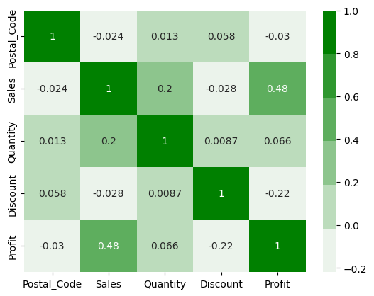
Data Correlation
we notice there's correlation between (profit, discount) and (profit, sales) and (quantity, sales)

Slide 5
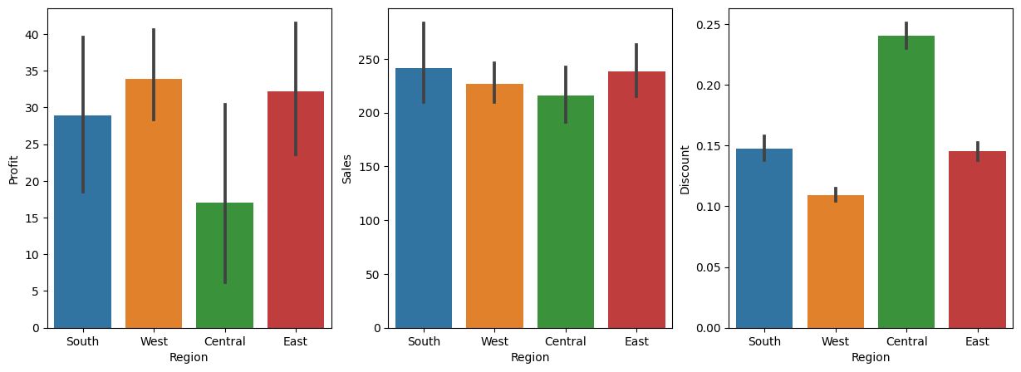
Correlation Profit, Sales and Discount For Each Region
West region has the highest profit and find same region has the lowest discount
South has the highest sales
Central has the lowest profit and has the highest discount and maybe that's the reason

Slide 6
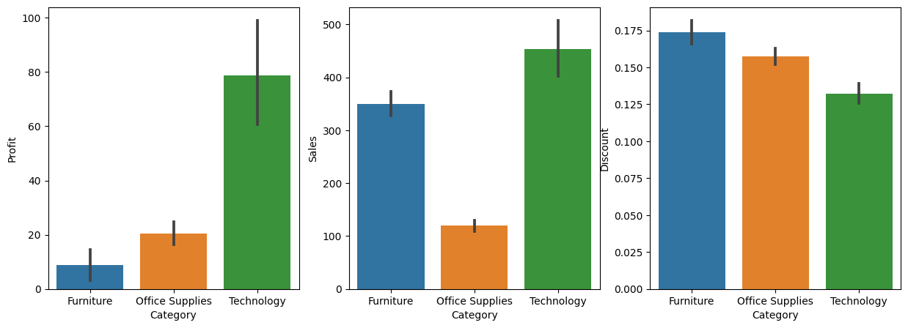
Correlation Profit, sales, and Discount For each Category
Furniture sales is high but has very low profit maybe high discount is the reason

Slide 7
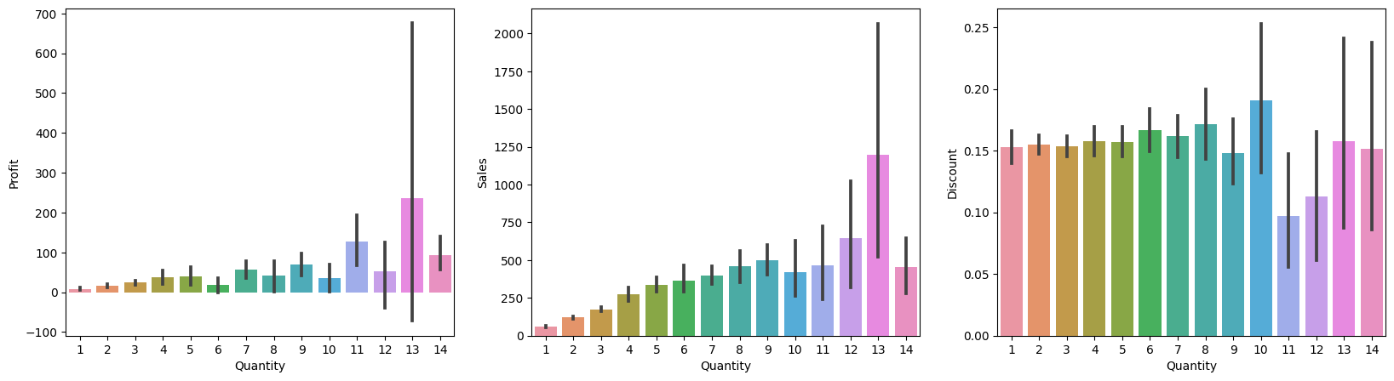
Correlation Profit, Sales, and Discount for each quantity
quantity 13 is the highest in sales and profit but number 10 is the highest in discount and gain lower profit
we need to balance between quantity and discount

Slide 8
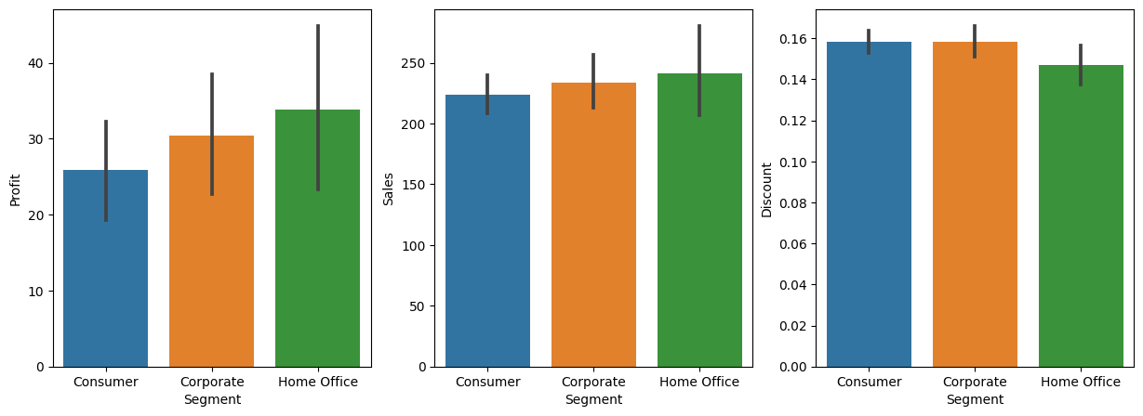
Correlation Profit, Sales and Discount for each segment
The Home Office offers the smallest discount but also achieves the highest profits from sales.

Slide 9
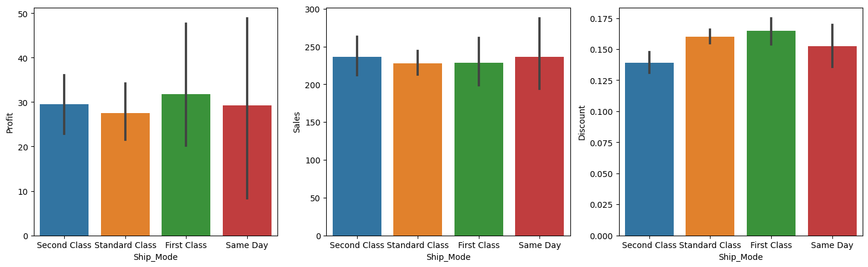
Correlation Profit, Sales and Discount for each Ship Mode
Same day shipping records the most sales, while First Class offers the highest discount, but it also results in the highest profits

Slide 10
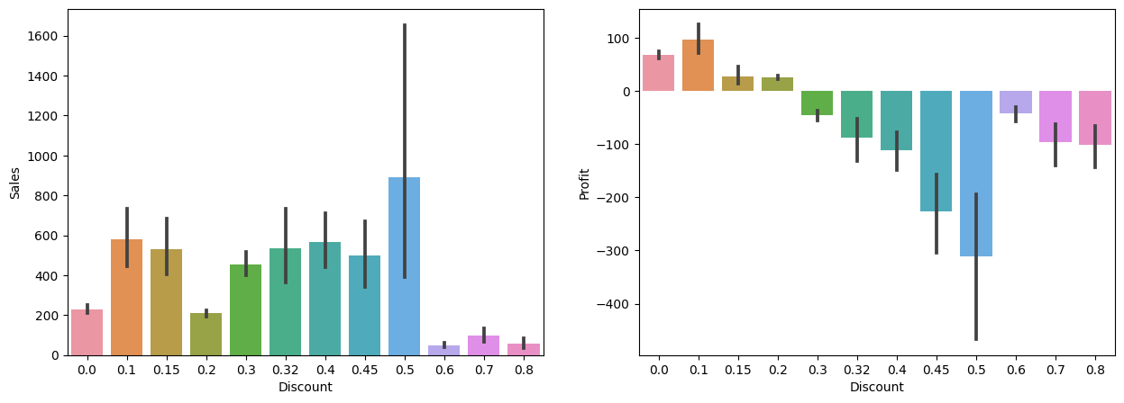
Impact Discount to Profit and Sales
we note when the discount is increased, profits tend to turn negative.

Slide 11
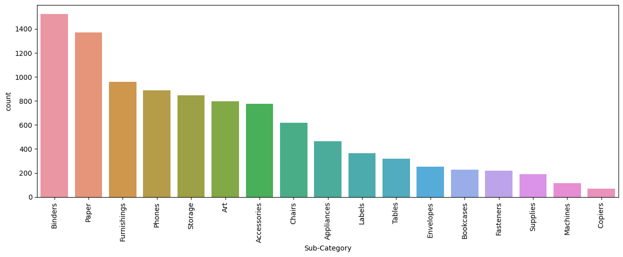
Product with the highest count
Sales of Binders and paper are the highest

Slide 12
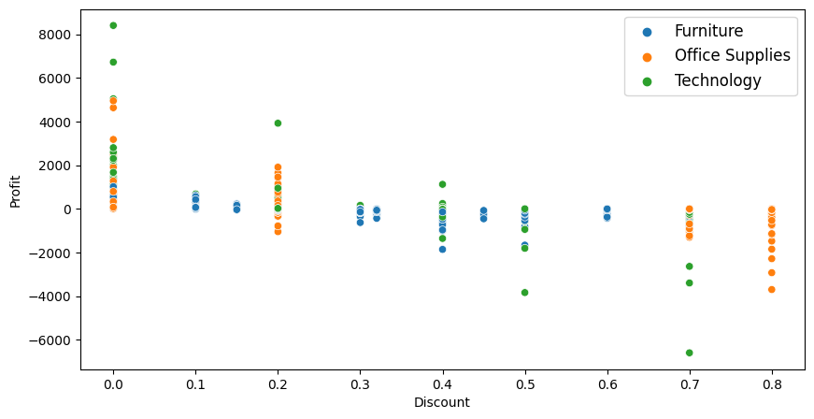
Category with Profit and Discount
Office Supplies incur the highest losses at an 80% discount
Furniture and Technology experience their greatest losses within the range of 30% to 50%.
Technology also suffers its most significant profit loss at a 70% discount.

Slide 13
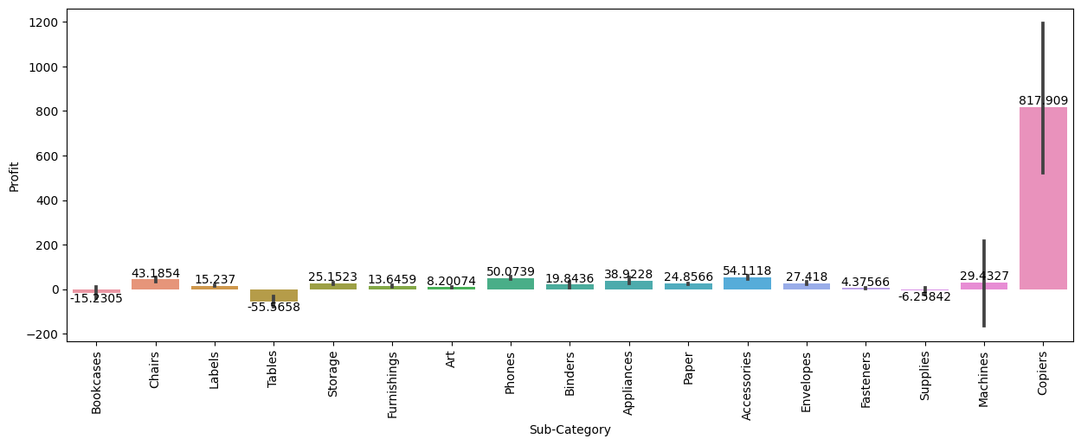
check Sub-category with profit
Tables, Supplies and Bookcases have negative profit

Slide 14
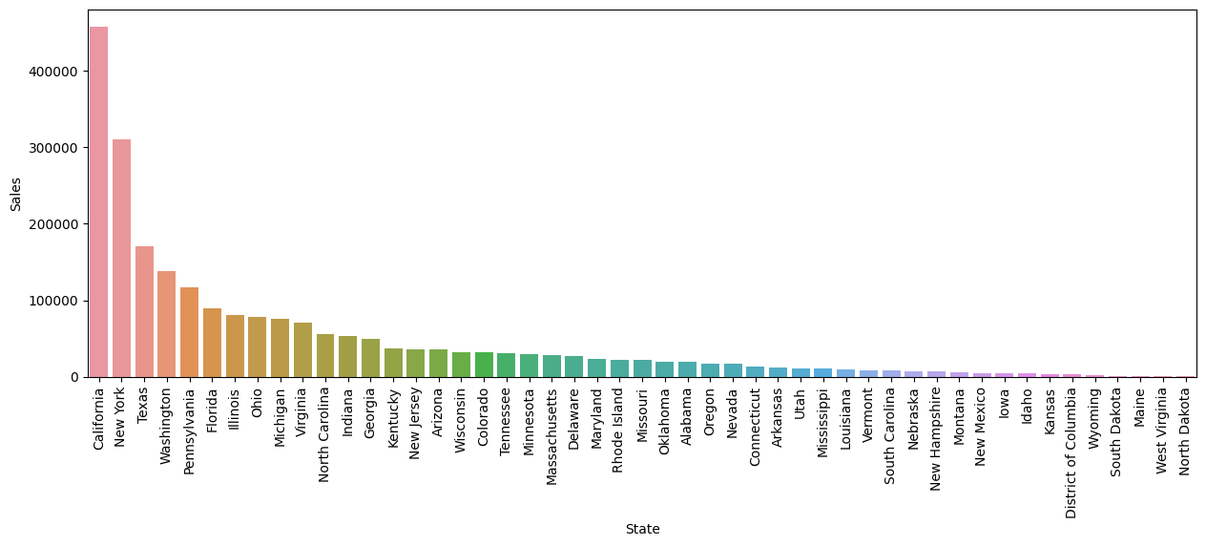
Sales with States
California and New York lead in sales, while many other states have lower sales.

Slide 15
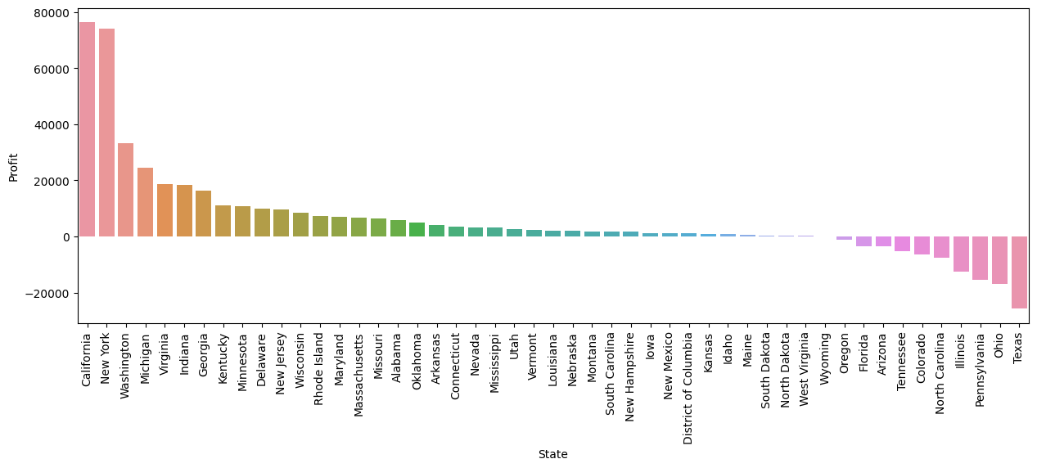
Profit with States
California and New York generate the highest profits, while some states have strong sales but negative profits.

Slide 16
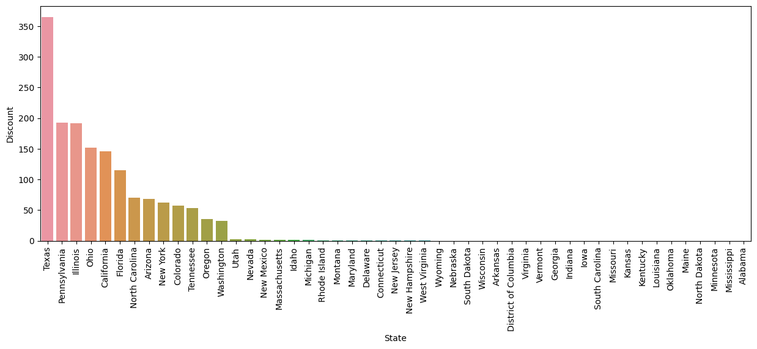
Discount with States
High discounts can sometimes result in profit losses, and this can be observed.

Slide 17
Summary

Slide 18
By analyzing the data, we can identify various business issues:
Technology outperforms Furniture in terms of profit.
Same-day shipping leads to higher sales.
The West region is the most profitable.
Vermont state achieves good profits despite low sales.
Discounts of 50% and less result in higher profits.
Offering more discounts in Furniture is necessary to attract customers.
In the Consumer segment, more discounts are needed, while Home-Office should be promoted to boost profits.

Slide 19
The areas where managers can improve profitability:
The relationship between sales and profit are not linear in most states.
The Central region need more focus.
Furniture and Office Supplies experience significant profit losses with high discounts.
Office Supplies incur maximum losses at both 80% and 0% discounts.
Furniture and Technology face their highest losses between 30% to 50% discounts.
Technology also records its maximum profit loss at a 70% discount. Tables, Supplies, and Bookcases within the sub-category show negative profits.

Slide 20
THANKS

